Slide 1
THE RECIPE
@KatsuGames
KatsuEntertainment
Katsu_entertainment
@StephaneImbert
www.katsugames.com
Notes:
How we got Sausage Bomber done and launched while working full time jobs!
Learn how we went about designing a simple game that would make us and players around the world laugh.
From napkin sized design to the Android, iOS and Amazon app stores, lessons learned and concrete examples from a real life project on how to be a wiener… uh winner!

Slide 2
Meet The Chefs
What is Katsu Entertainment?
Indie game studio
2 founders + contractors
Based in Cary, North Carolina
Who am I?
Stephane Imbert (co-founder)
20 years in the industry (EA, Katsu)
Engineer, designer, artist, etc.
@KatsuGames
KatsuEntertainment
Katsu_entertainment
@StephaneImbert
www.katsugames.com
Notes:
First of all, let me tell you a little bit about us.
I am the co-founder of Katsu Entertainment, an independent video game studio located in Cary.
The team for Sausage Bomber was the two co-founders of Katsu working with art and audio contractors.

Slide 3
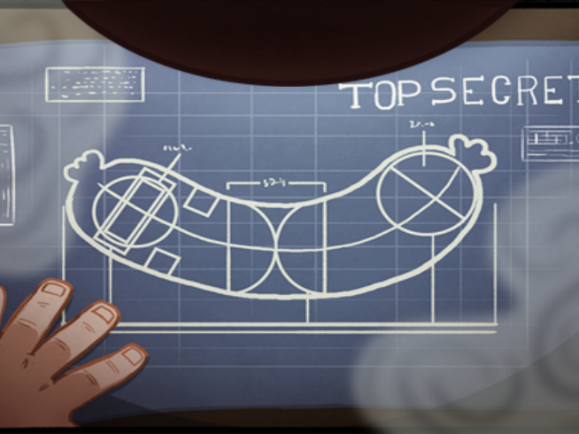
INGREDIENTS
Why Sausage Bomber?

Slide 4
Our Game History
Notes:
Katsu Entertainment has been around for about 3 years but we have worked on a lot of other games during our career.
From AAA sports titles at Electronic Arts to mobile game using some of the largest brand in entertainment and gaming.

Slide 5
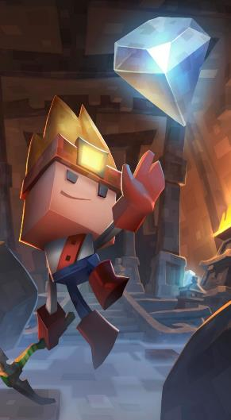
The History of Sausage Bomber
Working on Boulder Dash 30th Anniversary
Wanted to build up Katsu Entertainment’s portfolio
Limited time
Limited budget
Limited timeline
Build your IP… but be professional!
Notes:
We started Katsu Entertainment to develop Boulder Dash 30th Anniversary edition with one of the original creators of the 1984 classic as work for hire.
Since we just started we wanted to build our company portfolio and original IP.
We had limited time (because we were working on Boulder Dash during the day)
We had limited budget (because we were just starting as a company)
We had a limited timeline (because we wanted to get the game out for the company)
Building your own IP as an indie studio is the right thing to do but you have to be smart about it, you can’t jeopardize your revenue source for it.

Slide 6
The History of Sausage Bomber
Napkin idea
“Sausage Bomber”
We had to make it
No alcohol was involved
Go to dinner… also, no bad ideas.
Notes:
Question we get asked frequently: where did the idea for Sausage Bomber came from
You’ve all probably heard of how Toy Story, Monsters Inc., Finding Nemo and Bugs Life were all invented during a lunch break by the founders of Pixar.
My business partner Anthony Marinello was at dinner with some friends and were talking about the craziest game names they could think of.
One of our friends said “sausage bomber”, Tony didn’t know what that game was but he knew we had to make it.
I’ve been told no alcohol was involved but I wasn’t there…
Point is there are no bad ideas.

Slide 7
Early Direction
Portfolio piece
Simple yet addictive
Mobile premium
Play it straight
Make ourselves laugh
Developed in our spare time
BUT developed on a deadline
Daylight PrecisionSausage Bombing
Spare time != no deadline
Notes:
The key point here is, just because you are developing something in your spare time doesn’t mean you shouldn’t have a deadline.

Slide 8
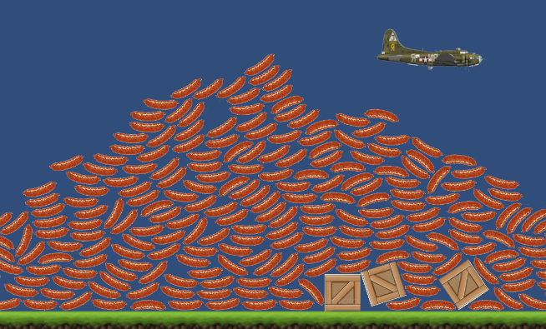
PREHEAT THE OVEN
Early concepts and designs

Slide 9
Good - Cheap - fast
Limited budget means cheap
Portfolio piece means good
Deadline means fast
Go for Cheap + Fast (prototype)
Go for Good + Fast (early work)
Go for Good + Cheap (bulk)
GOOD
CHEAP
FAST
Low budgets suck so… budget!!
Notes:
Good, cheap and fast: you can only have two at a time in any creative endeavor.
In our case we wanted all three to meet our business goals.
The key is you do not need all three at once. Depending on where you are in the development cycle, focus on the two you need at that moment.
Working with a limited budget (especially a low budget) sucks, so make sure you have a budget so you don’t waste the little resources you actually have.

Slide 10
A Taste of Greatness
GOOD
CHEAP
FAST
First playable
Super quick turnaround
Placeholder everything
Unlimited sausages
Dropping sausages is funny
Ok, we have something there
Get to playable a.s.a.p.
Notes:
First thing was to get to playable as quickly as possible to figure out what we didn’t know.
This was done in one weekend and the goal was to prove or disprove the idea quickly.
We grabbed placeholder images from a google search and created a quick and dirty prototype of dropping sausages from a plane.
Not really a game but it told us that dropping sausages from a side scrolling plane and trying to hit crates was fun.

Slide 11
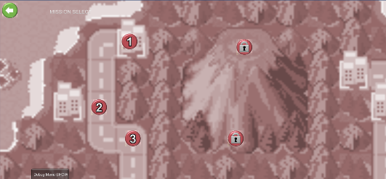
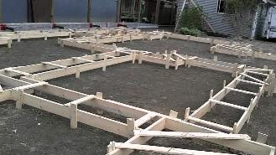
First playable
GOOD
CHEAP
FAST
Keep it loose
Keep It Stupid Simple (KISS)
Keep with placeholders
Nail down your mechanics
Don’t pretty up your foundations
Notes:
Then we turned the prototype into an actual playable.
We knew we had limited resources so we needed to keep things stupid simple (KISS) to have a chance to finish in our timeline.
Still working loose and using placeholders: the goal was nailing the game mechanics.
At this point you’re working on your foundations, focus on making them solid, not pretty.

Slide 12
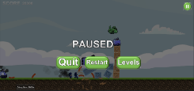
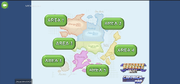
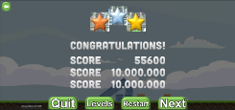
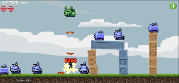
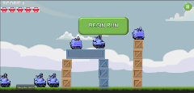
Skeleton flow
GOOD
CHEAP
FAST
Ugly but functional
Not fully functional…
… but COMPLETE flow
Get a sense of scope
Allow parallel development
“Shippable”
Notes:
Next we created the entire flow of the game from the critical path down to the credits screen.
Screens weren’t entirely functional, some were just placeholder UI buttons to go in and out of the screen.
The point here was that we could go to any part of the game so we could
Get a sense of how much work was ahead of us and
Work on any part of the game without having to wait on dependencies
This was our first “shippable” version of the game, meaning we had all the pieces we needed to put a (crappy) game in the app store (by just replacing the placeholders and turning off the screens that weren’t functional yet, of course this would be a worst case scenario and we had no intention of shipping at that level of quality).

Slide 13
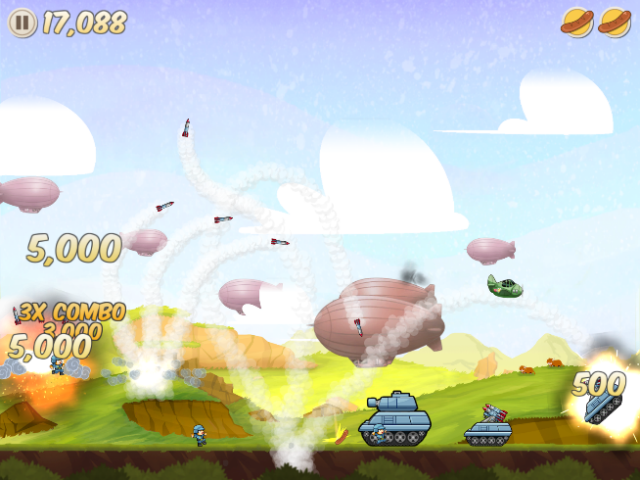
Cook on high
Plan how to get it done…

Slide 14
Planning
GOOD
CHEAP
FAST
Low budgets suck so… BUDGET!
Plans suck so… MAKE A PLAN!
Low-cost but deep dive
Sketches, lists, etc.
Whatever gets the point across
Work towards a backlog
It’s all throw away anyway
Notes:
Again, planning sucks, especially if you have hard constraints like a low budget.
But planning is a crucial part of getting something done.
We use Agile development but we have enough experience with other systems (waterfall, kaiban, etc.) to know when to use one system or another.
Planning is something to do cheap and fast, but it’s still something you want to do AND you want to take a deep dive.
Use the simplest thing that will get your point across for both planning and design, sketches, spreadsheet, notes on paper, whatever works (and quickly)
All your planning is throw away because (a) your players will never see it and (b) your plan will change over time, so don’t spend a lot of time on it. Get it done cheap and fast.

Slide 15
Backing the log
GOOD
CHEAP
FAST
Everything 1 to N
Detailed for top priorities
Loose for low priorities
Your (realistic) end goal
How far before you reach it
PUT SOME DATES ON IT!
Notes:
This is the single most important thing to get your project FINISHED.
Agile backlog.
Prioritize your N items from 1 to N, don’t use “buckets” like MSCW (Must, Should, Could, Won’t) or priority level, it never works (because everything is important). Prioritizing is hard but make sure everything is more or less important than anything else, no two items should have the same priority.
Detail the items you’ll be working on right now, don’t waste time detailing what you’ll be working on in a while (because it will most likely change by the time you get to it).
Make sure your backlog is reasonably realistic for your time and budget, otherwise you’ll never feel like you can get it done and there is no better motivation killer than that.
The backlog will tell you what you have to do and how far you are from finishing it.
Put some rough dates at key points in your backlog so you know how you’re doing against your timeline.
If you miss a date, add a new one and strive to hit that new date. You’ll be amazed how quickly your deadline approaches when you’re not paying attention to time.

Slide 16
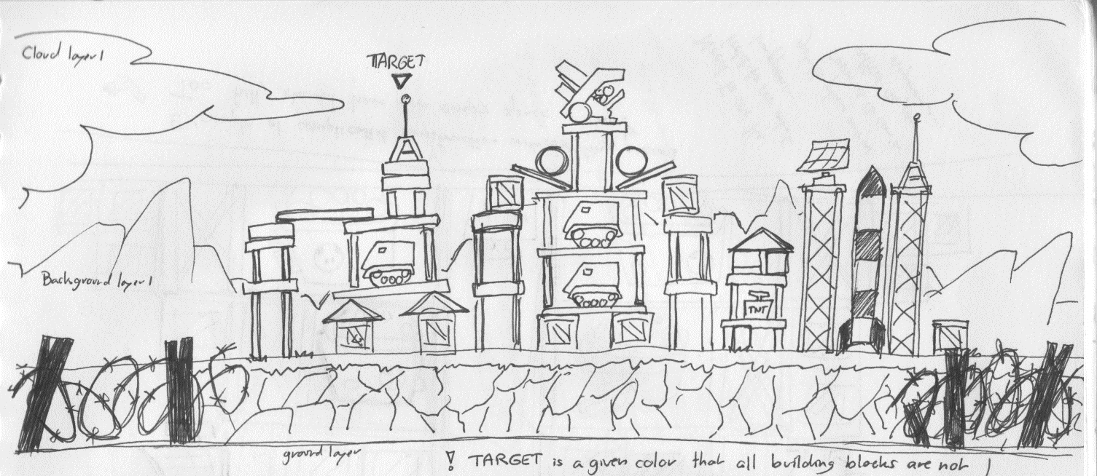
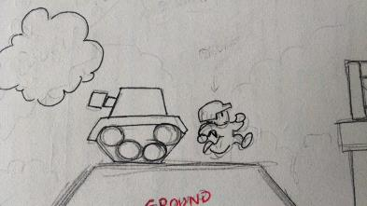
Early sketches
GOOD
CHEAP
FAST
Notes:
Bare minimum you need to get the point across.
These pencil and paper sketches were our entire designs.
They look rough and simple but you can tell a lot from there.
* we need props to create structures for levels (crates, beams, etc.) * we need separate layers for 2D parallax (sky, clouds, background, ground)
* we need to keep the foreground elements thin and small so they would not obstruct the view (barb wire)
* we need some human characters so the level does not feel deserted
* we need some background elements to make the level feel more alive (blimps, lights, etc)

Slide 17
Visual inspiration
Notes:
Our visual inspiration for the game came from two main sources:
Advance Wars: a serious war game with very happy and colorful art. This art style was perfect for playing it straight with Sausage Bomber. We knew we wanted to create a war torn world where sausage bombing was the last hope of a country surrounded by invaders. It had to be a word that was hopeful and colorful despite its setting and it had to be a word where dropping sausages from planes was something that was plausible yet surprising.
Samurai Jack was a visual inspiration on how to achieve strong themes through a stylized art style using simple bold and colorful shapes to capture the essence of the story.

Slide 18
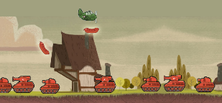
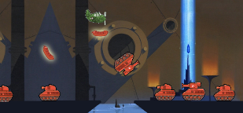
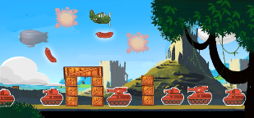
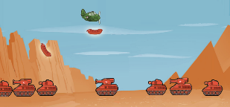
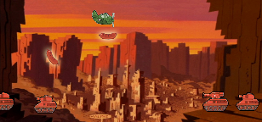
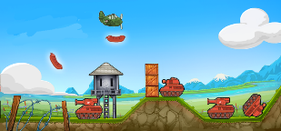
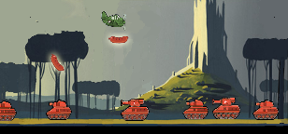
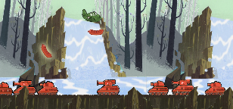
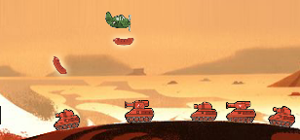
Visual Exploration
GOOD
CHEAP
FAST
Notes:
We made these quick visual explorations by combining different elements in Photoshop.
This entire process took only a day (cheap and fast)
We combined the early sprites from the concept artist, with sprites from sausages we grabbed online and background image we also found online that had the style we were looking for (or elements of style we were looking for) This allowed us to see what worked and what didn’t from each approach and figure out the visual language (rules) for our game.
We combined the elements that worked into the image in the upper right corner to establish the first look for what Sausage Bomber would ultimately looked like (bright blue sky, rolling hills and castle ruins, strong foreground elements that don’t obstruct the action…)

Slide 19
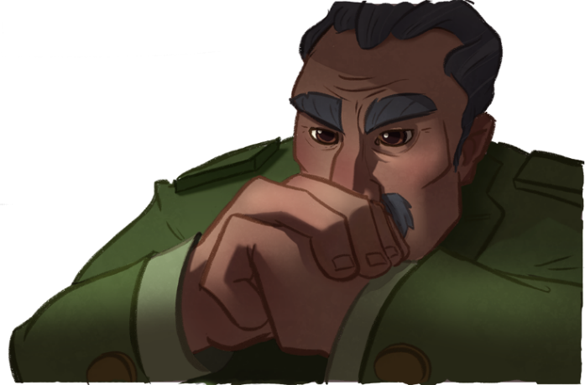
Concept Art
GOOD
CHEAP
FAST
Notes:
Concept art is a very powerful tool at your disposal when making a game.
Concept artists are expensive but they create awesome artwork very fast, and are well worth the investment.
You want somebody like our concept artist, Tanith Connolly, who can grab your idea or your rough sketch and turn it into an awesome piece of artwork that sets the mood for your game.

Slide 20
Pilots evolution
GOOD
CHEAP
FAST
Notes:
Tanith also helped us nail down the style of our hopeful young pilots of the Sausage Corps.
We quickly iterated through steps by steps to define the look we would eventually launch with.
Being able to iterate quickly back and forth with the concept artist was a key element to nailing down the style.
Long story short: concept artists are well worth your investment. If there’s one place to spend, that’s the one.

Slide 21
The fun part
Coolest part of the project
Design cool stuff!
Draw cool stuff!
See cool stuff!
Motivation is a piece of cake
Unfortunately…
Notes:
This is all great and it’s the fun part of the project.
It’s easy to stay motivated through it but then the less fun part begins…

Slide 22
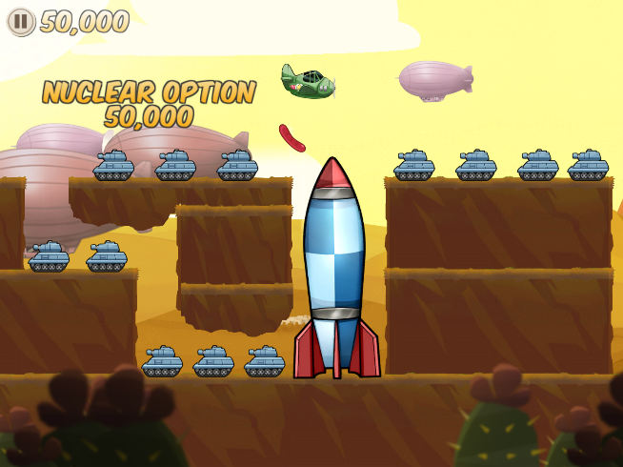
LET IT SIMMER
How you actually get it done…

Slide 23
Keep making progress
Always make SOME progress
“Butt in chair”
A marathon, not a sprint
Notes:
The key to getting something done is to always make some progress.
Doesn’t have to be much, doesn’t have to be great progress, just has to be progress (even progress in the wrong direction is better than stagnating).
Use the “butt in chair” mentality from book writers, it doesn’t matter what words you’re typing, just sit down and start typing.

Slide 24
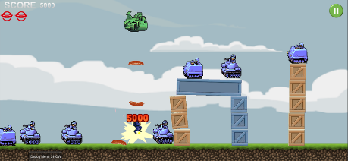
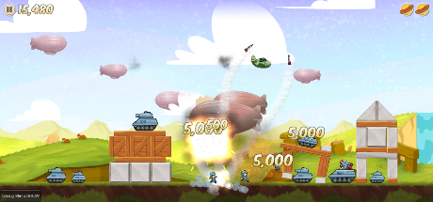
Do it incrementally
Could give entire talks on this (I did)
Increments of “shippable” quality
The “Hit by a bus” mentality
Learn what you don’t know
F
D
C
B
A
NOT TESTABLE
FIRST PLAYABLE
FIRST SHIPPABLE
LAUNCH VERSION
UPDATES
Notes:
Not going to go into too many details but strive to reach a “shippable” product as early as possible (the earliest the better)
Note that “shippable” here doesn’t mean “good”
Think of the worst game you’ve ever played, picture it.
Get your game to that level first.
Then work on making it better with every iteration.
Why? Three reasons:
Once you have something shippable you’ve done most of the “not fun” hard work and you can focus on the fun part again
Worst case scenario if you have to release the game before you’re happy with it, at least you can release “something”
You can learn a lot from your first crappy shippable, what works, what doesn’t, what people like and don’t like <= this is extremely useful

Slide 25
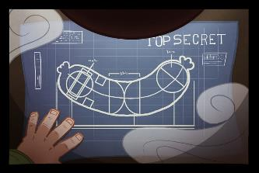
Kill your darlings
Keep scope in check
Keep yourself in check
Be smart where you cut
Single faction
Inexpensive audio
Random backgrounds
Be smart where you don’t
Intro and outro movies
128 levels
Notes:
Another concept from book writing
Don’t get attached to ideas, you may have to kill your darling ideas to meet your goals (time, budget, etc.)
Be smart about cutting things that won’t matter in the grand scheme of things and can save you time
Be smart about keeping what you think will make a noticeable difference in your game

Slide 26
Assets bulk
GOOD
CHEAP
FAST
Notes:
At this point you are ready to create the bulk of your assets.
The good news is by this point you’ve already done all the hard work of planning and figuring things out.
What remains is just executing on your plan.
This is where you can trade FAST for GOOD because you know what you’re making and getting it done fast is less important than making it GOOD.
This is assuming you’re still working with a low budget and CHEAP is a requirement.

Slide 27
128 levels
Not all of them great
Not all of them on first try
Time consuming
You’re going to run out of ideas
Just slap some tiles together and go from there
Notes:
One quick note on levels: we knew we wanted 128 levels in the game and creating that many levels is difficult.
The key to creating that much content is realizing that not all of your content with be great, especially not on the first try.
Creating levels is time consuming (towards the end we could make one level from idea to tuning in 1hr, so at best we would spend a minimum of 128hrs just on levels)
You’re eventually going to run out of ideas as well so use everything we’ve talked about up to this point, sit down and just slap tiles together quick and dirty, then iterate.
Don’t expect to make a genius level every time without effort, slow and steady wins the race.

Slide 28
Eyes on the prize
How to stay motivated?
Remember your goals
What is success?
Set clear expectations
You don’t control fame
You don’t control fortune
You control quality
Stick to your dates
When you don’t, set new ones

Slide 29
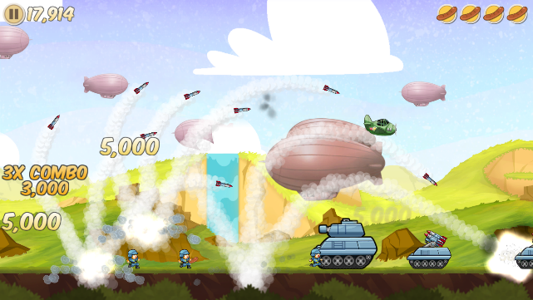
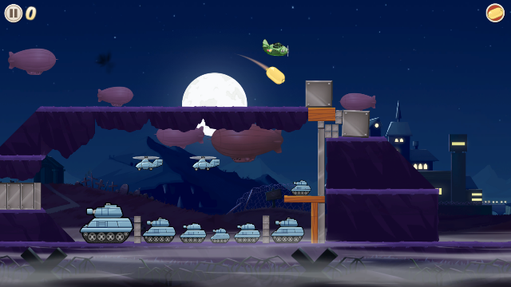
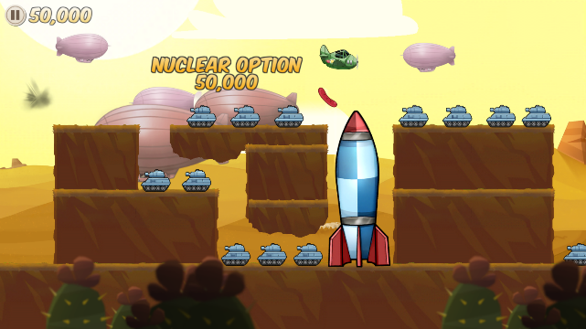

Slide 30
PLATING
How did we launch the game?

Slide 31
Marketing
Get players to know you before you try to sell them something
Social media is a time sink
Releasing a game takes time and effort
MAKE A PLAN
Content, content, content…
Notes:
Marketing is as much a part of making a game than anything else.
It must be part of your plan from the very beginning.
Marketing is very time consuming and it’s hard to do when you’re already spending all your spare time making the game so plan for it.

Slide 32
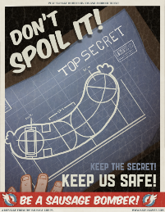
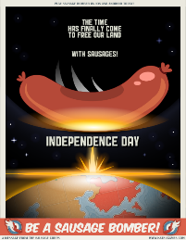
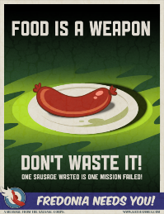
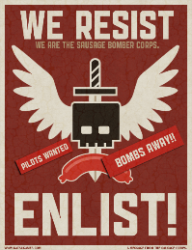
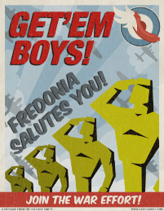
Content, Content and Content
Notes:
Propaganda posters to use on social media.
Also make awesome prints ☺

Slide 33
THANK YOU!
Tell us what you think!
@KatsuGames
@StephaneImbert
KatsuEntertainment
Katsu_entertainment
www.katsugames.com
Download the game now!
Notes:
Download the game
iOS https://itunes.apple.com/us/app/sausage-bomber/id1106086912?mt=8
Android: https://play.google.com/store/apps/details?id=com.katsu.sausagebomber1&hl=en
Amazon: https://www.amazon.com/Katsu-Entertainment-Sausage-Bomber/dp/B01H5PHPU0/
Get the t-shirts: https://www.amazon.com/Sausage-Bomber-Vintage-Target-T-Shirt/dp/B01L5ZM9IO

