Slide 1
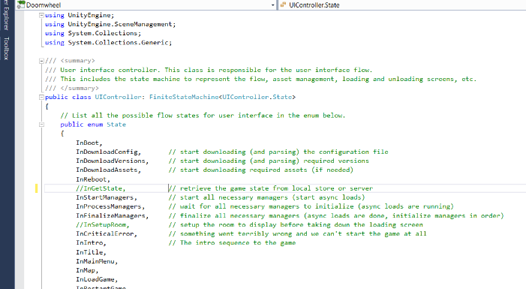
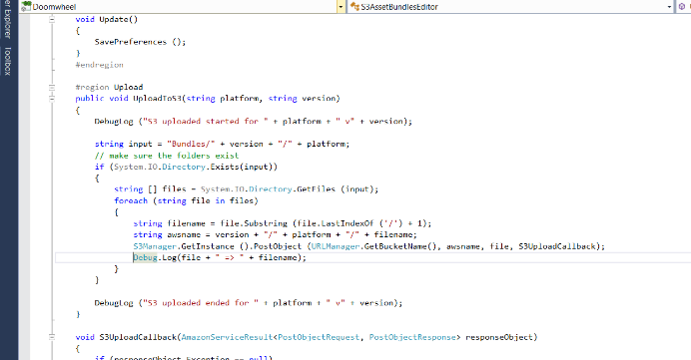
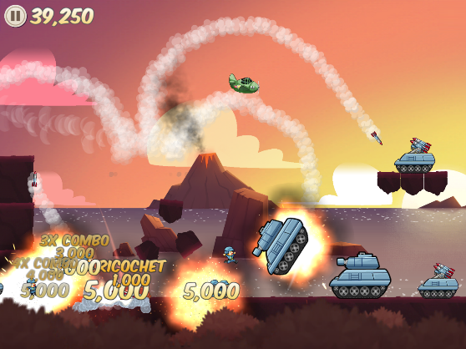
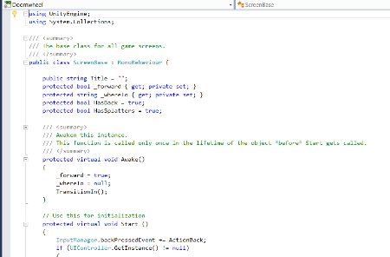
The Unsung Code
Tales of IFs, WHILEs and other loops.
@KatsuGames
KatsuEntertainment
Katsu_entertainment
@StephaneImbert
www.katsugames.com
Notes:
Rendering is AWESOME! Audio is AWESOME! Gameplay is AWESOME!
So let’s talk about everything else instead.
We’ll cover all the unsung code that players will never know is there but can make the difference between smooth sailing and development hell.
How to tackle the glamour-less “must do” in a way that leaves room for all the fun fluff, or risk the wrath of the bitter hordes of “braindead code that should only have taken five minutes to write”!

Slide 2
Who am I?
Stephane Imbert
Katsu Entertainment, co-founder
20 years in the industry
Engineer
UI Lead
Team Lead
Technical Director
Director of Development
Tiburon/EANC/EASL/EAJ/Katsu
@KatsuGames
KatsuEntertainment
Katsu_entertainment
@StephaneImbert
www.katsugames.com
Notes:
First of all, let me tell you a bit about myself.
Been in the industry for almost 20 years working for Electronic Arts before co-founding Katsu Entertainment.
During that time I’ve worked my way from engineer to director of development.

Slide 3
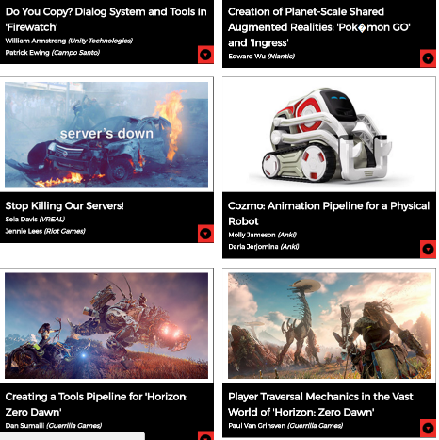
What is this about?
Not graphics, audio, gameplay…
Not pipelines or tools
Code you never hear about
Not “glamorous” but super useful
Equally as important as the rest
A generalist approach to games
Notes:
What is the unsung code?
While looking for ideas for talks from previous conferences I found a lot of talks about graphics, audio, pipeline, etc.
All great topics, all really important for making videogames but somewhat different from my own work experience.
I wanted to talk about code that is never brought up despite being as important as anything else in games.
The type of code you work with as a generalist.

Slide 4
In other words…
HIGH DEF GRAPHICS
NETWORK,
OBVIOUSLY…
AUDIO SMASH!
SPEED AND OPTIMIZATION
GAMEPLAY
NARRATIVE
PHYSICS!
Uh… eye
tracking?
THE UNSUNG CODE, FOOLS
Notes:
The underlying force that makes the whole better than the sum of its parts.

Slide 5
Why is it important?
Every game needs it
From the most complicated
To the simplest
Often overlooked or taken for granted
Can really ruin your day if you do not get it right
Surprisingly easy to get it wrong

Slide 6
In other words…
I HAVE HAD IT WITH THESE M%#@$ SNAKES ON THIS M%#@$ PLANE!
Notes:
If you’re not careful, you’ll find yourself having a very bad day for as silly a reason as somebody deciding to put snakes on a plane.

Slide 7
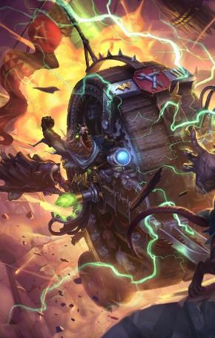
20 years of experience
Boulder Dash 30th Anniversary
Sausage Bomber
Doomwheel
Notes:
Code shown is result of 20 years iteration, starting with AAA sports titles at Electronic Arts, and has shipped in all Katsu games.
You can get Sausage Bomber right now from the app store to see the code in action.
=> https://itunes.apple.com/us/app/sausage-bomber/id1106086912?mt=8
=> https://play.google.com/store/apps/details?id=com.katsu.sausagebomber1&hl=en
Doomwheel is still in development and coming out later this year.

Slide 8
User interface and game flow
The perfect example of “simple gone crazy” in 5 steps or less
Notes:
Focus on one example to fit in the 1hr time slot, but lots more unsung code.

Slide 9
What is that?
“Glue code”
Wibbly Wobbly Gamey Wimey stuff
Structure of your game
Drives player experience
Drives user interface
Drive systems
And more…
State machine
Notes:
What is the game flow? The glue code that makes all the other parts of your game work together.
It drives the flow of screens (which drives the experience of your users).
It also drives the back-end systems (initialization and updates)
The game flow IS a state machine, trying to implement it any other way is a recipe for disaster.

Slide 10
Let’s start easy
HEAD or TAILS
COIN TOSS
RESULT
Notes:
What’s the easiest game you can think of?
Mine was “coin toss”.
Choose heads or tails, toss the coin, see if you won, then repeat.
This is already a game flow.

Slide 11
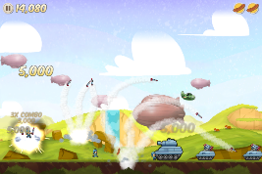
Sausage Bomber
Begin
Boot
Rate This App
YES
Tutorial
Play
Playing for 1st time?
On timer
NO
Title
Main Menu
Missions
Briefing
NO
YES
Fly
Intro movie
Playing tutorial level?
Loading
Pause
Drop
Options
Collection
Watch
Reset the game?
Results
Not enough currency
Buy this item?
Language
Credits
Watch Ad
Victory movie
Notes:
Looking at a simple game with a linear critical path.
Sausage Bomber is a simple level based physics puzzle game.
The critical path is linear and straightforward: start the game, choose a level, play the level, see the results, go to next level.
However the flow gets more complicated when you had the side screens you need to launch the game (pause, options, collection, etc.)

Slide 12
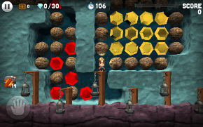
Boulder Dash
BOOT
Controls
Title
Languages
Not enough
Level Info
IAP popups
IAP Store
Restore purchases
Odds
Main Menu
Treasure chests
Reset the game
Level select
Credits
Collection
Options
Characters
Loading
Rate this app
Results
Play
Briefing
Pause
Notes:
Boulder Dash is also a level based physics puzzle game with a linear critical path.
But the flow of the peripheral screens gets a bit messy. What’s going on there?

Slide 13
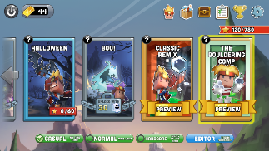
Boulder Dash
BOOT
Title
Not enough
Level Info
Odds
IAP popups
IAP Store
Main Menu
Controls
Treasure chests
Languages
TOP BAR
Level select
TOP BAR
Restore purchases
Collection
Loading
Reset the game
Results
Pause
Characters
Credits
Options
Play
Briefing
Rate this app
Notes:
This is because Boulder Dash has a navigation bar at the top of the screen to access side screens like characters, collection and options.
This top bar is used in several different screens making the flow more complicated.
We can simplify the previous slide by combining all the top bar flow into a single flow.
We’ll see code to handle that type of flow.

Slide 14
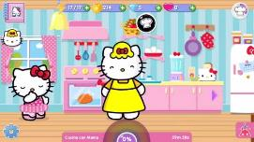
Hello Kitty W.O.F.
Reboot
BOOT
Downloads
Download
Errors
Add friend
World Map
Get Saved State
News of the day
Friends list
Transfer game
City Map
Managers Start Up
IAP Store
Languages
Inventory
Intro
Title
Photo album
About
Clothing store
HUD
Options
Help
Daily Bonus
Starter Pack
Story dialogs
Activity complete
Level up
Rate this app
Quests log
Unlocks
Notes:
Hello Kitty is a narrative driven game loosely based on Kim Kardashian Hollywood by Glu Mobile.
Seems like an easy game to make but surprisingly complicated flow.
A lot of the game is in the UI with no clear critical path through the screens and a lot of branches between sections like store, collection, etc.
Note, I won’t show an EA Sports title game flow for the sake of time plus the fact that these games can easily feature over 100-150 different screens.

Slide 15
Piece of cake… NOT
Big state machine
Branching and cycles
PLUS
System dependencies
PLUS
Screen animations
Button mashing
Notes:
So, the game flow is a state machine but it’s more complicated than you think
It grows up exponentially with the number of screens in your game, it has branches and cycles…
PLUS it drives low level systems as well as UI, including system dependencies (which system needs to start first…)
PLUS transitions are asynchronous (screens usually have visual transitions) and button mashing is a predominant problem when dealing with keyboard or controller inputs.

Slide 16
WHAT TO DO
KEEP
IT
STUPID
SIMPLE
WAIT… WHAT?
Notes:
KISS so you don’t waste your time on what’s easy (and spend it on the other cool features we’re not talking about here ☺)
Players can’t see the unsung code when it works well, make sure they don’t get to see it working poorly
Spend your time on what they will see.

Slide 17
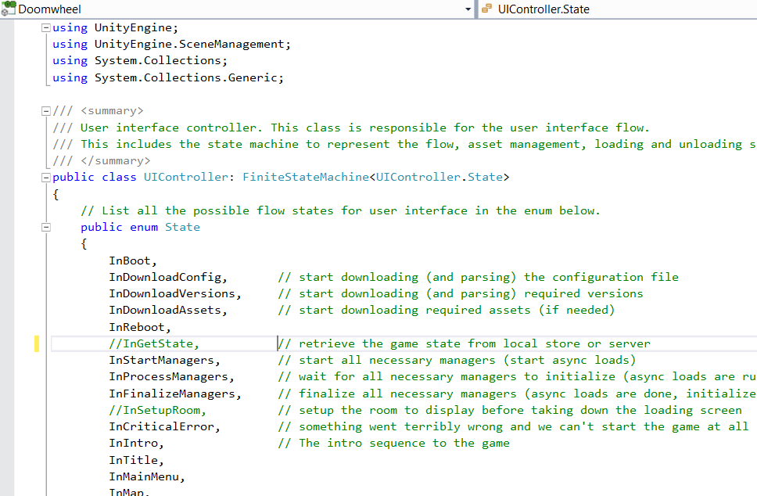
The good news
Actually quite simple to get it right
You must follow a few rules
Game flow IS a state machine
Only one state at a time
Only one transition at a time
No interruption during transitions
No cycles
States do NOT know the flow…
… only flow manager does

Slide 18
What you need…
UIController.cs (or FlowManager.cs)
enum State {...};
void MoveForward(string whereto);
void MoveBackward();
ScreenBase.cs
void TransitionIn();
virtual void StartTransitioningIn();
virtual void FinishTransitioningIn();
void TransitionOut();
virtual void StartTransitioningOut();
virtual void FinishTransitioningOut();
InputManager.cs
void EnableInputs();
void DisableInputs();
Notes:
Made in C#/Unity but can be easily adapted to any system (over the years was implemented in C#/C/C++/ActionScript/proprietary scripting system…)
We’ll detail each of these in later slides
Won’t talk about input manager because it’s trivial and specific to your code

Slide 19
SCREENBASE.CS #1 (animation)
TransitionIn
NO INPUT
StartTransitioningIn
void TransitionIn() // move forward in the flow
{
InputManager.DisableInputs();
StartTransitioningIn();
}
virtual void StartTransitioningIn()
{
// do animation however you want (tween, script, co-routine, etc.)
// simply call FinishTransitioningIn() when finished
}
virtual void FinishTransitioningIn()
{
InputManager.EnableInputs();
}
void TransitionOut() // move forward in the flow
{
// cached _forward (bool) and _whereto (string) before calling this
InputManager.DisableInputs();
StartTransitioningOut();
}
virtual void StartTransitioningOut()
{
// do animation however you want (tween, script, co-routine, etc.)
// simply call FinishTransitioningOut() when finished
}
virtual void FinishTransitioningOut()
{
if (_forward) UIController.MoveForward(_whereto);
else UIController.MoveBackward();
}
FinishTransitioningIn
INPUT
Player goofs around in the screen
TransitionIn
NO INPUT
StartTransitioningIn
FinishTransitioningIn
Notes:
The base class that all screens derive from.
Follow the structure shown here to get rid of 99% of button mashing issues (Input locks)
The gist of it is disable inputs during transitions, from the moment you make the decision (even before the current screen animates out) to the moment the *next* screen finishes its animation in.
Transition functions (animations) are virtual so we can create a default animation that works for 90% of our screens but still override for the 10% that need a custom behavior.
The Finish functions are also virtual for the rare cases that need a different behavior.
Will go over the UI controller functions in a later slide.

Slide 20
SCREENBASE.CS #2 (FLOW)
string _whereto = null; // cache during transition, NOT a state, a key agreed upon by screen and controller
string _forward = true; // cache during transition
void ActionGoBack() // move backward in the flow
{
_forward = false;
TransitionOut();
}
void ActionDoSomethingCool()
{
// player presses the button to do something cool
_forward = true;
_whereto = “somethingCool”;
TransitionOut();
}
void ActionDoSomethingAwesome()
{
// player presses the button to do something awesome
_forward = true;
_whereto = “somethingAwesome”;
TransitionOut();
}
void ActionDoSomethingTerrific()
{
// player presses the button to do something terrific
_forward = true;
_whereto = “somethingTerrific”;
TransitionOut();
}
BACK
SOMETHING COOL
SOMETHING AWESOME
SOMETHING TERRIFIC
Notes:
Different “actions” to react to user input (in the example shown, tapping a button calls the associated “Action()” function)
Each action transitions out.
We store the direction (forward or back) and an additional parameter because the transition is asynchronous.
We will only move to the next state after the current screen has finished its animation.
The _whereto parameter is a contract between the screen and the flow. It does not map to an actual state, it is just some key the flow knows to expect from the screen to make its decision as to which state to go to next.

Slide 21
UIController.cs #1 (FLOW)
enum State { A, B, C, D } // all states go here
void MoveForward(string whereto) // move forward in the flow
{
switch (_state)
{
case State.A: if (whereto == “GoToB”) _state = State.B;
else if (whereto == “GoToC”) _state = State.C;
else Debug.LogError(“I’m lost moving forward in “ + _state + “ going to “ + whereto);
break;
case State.C: _state = State.D;
break;
default: Debug.LogError(“I’m lost moving forward in “ + _state); break;
}
}
void MoveBackward() // move backward in the flow
{
switch (_state)
{
case State.B: _state = State.A; break;
case State.C: _state = State.A; break;
case State.D: _state = State.C; break;
}
default: Debug.LogError(“I’m lost moving backward in “ + _state); break;
}
B
A
C
D
Notes:
The UI controller is a very simple state machine.
Each state is an enum.
The transition functions check which state we’re currently on and decides which state to go to based on the input parameter (if necessary)
The distinction between “forward” and “backward” is for convenience when dealing with more complicated flows (KISS)
It’s really convenient as a mental construct to know if you’re currently moving forward in your flow (making a selection) or backward (cancelling or retuning to the previous screen)

Slide 22
UIController.cs #2 (STATES)
void AAA_Start() // do whatever you want to start/enter the state
{
_screen = LoadScreen(“MainMenu”);
}
void AAA_Update() // do whatever you want to update the state (every tick)
{
_screen.UpdateAnimation();
}
void AAA_End() // do whatever you want to end/exit the state
{
_screen = null; // (unload)
}
void BBB_Start() // example of automatic transition
{
StartMovie(“Bee Movie”);
}
void BBB_Update()
{
if (MovieIsDone()) MoveForward(null); // null because there’s only one way to go
}
void BBB_End()
{
}
...
Notes:
States are super simple: start function, update function and end function.
I am using screens in these slides to keep things simple while still dealing with the added complexity of asynchronous transitions.
This flow structure works for other systems as well.

Slide 23
Let’s start easy
HEAD or TAILS
COIN TOSS
RESULT
Notes:
Let’s go back through our examples: simple flow

Slide 24
Linear flow
enum State { Choose, Toss, Results } // all states go here
void MoveForward(string whereto) // move forward in the flow
{
switch (_state)
{
case State.Choose: _state = State.Toss; break;
case State.Toss: _state = State.Results; break;
case State.Results: _state = State.Choose; break;
default: break;
}
}
void MoveBackward() // move backward in the flow
{
}
Notes:
No branching, the flow is purely linear. From each state there is only one other state to go to.
We always move forward in the flow, we never go back.

Slide 25
Sausage Bomber
Begin
Boot
Rate This App
YES
Tutorial
Play
Playing for 1st time?
On timer
NO
Title
Main Menu
Missions
Briefing
NO
YES
Fly
Intro movie
Playing tutorial level?
Loading
Pause
Drop
Options
Collection
Watch
Reset the game?
Results
Not enough currency
Buy this item?
Language
Credits
Watch Ad
Victory movie
Notes:
Adding branching

Slide 26
Simple flow with branch
enum State { MainMenu, Options, Language, Credits... } // all states go here
void MoveForward(string whereto) // move forward in the flow
{
switch (_state)
{
case State.MainMenu: if (whereto == “options”) _state = State.Options;
else ...
break;
case State.Options: if (whereto == “language”) _state = State.Language;
else if (whereto == “credits”) _state = State.Credits;
else ...
break;
...
}
}
void MoveBackward() // move backward in the flow
{
switch (_state)
{
case State.Language: _state = State.Options; break;
case State.Credits: _state = State.Options; break;
case State.Options: _state = State.MainMenu; break;
...
}
}
Notes:
From one state we can go to more than one state.
We use the optional whereto parameter to determine where to go next.
Remember that _whereto is a key, not a state. In other words, the screen tells the flow “this is the decision the player made” and it’s up to the flow to translate that into the appropriate state transition.
Also note that backward has no branching. If you find yourself wanting to branch on backward, take another hard look at your flow. Cycles are complicated not only for you but for your players as well.

Slide 27
Boulder Dash
BOOT
Title
Not enough
Level Info
Odds
IAP popups
IAP Store
Main Menu
Controls
Treasure chests
Languages
TOP BAR
Level select
TOP BAR
Restore purchases
Collection
Loading
Reset the game
Results
Pause
Characters
Credits
Options
Play
Briefing
Rate this app
Notes:
Top bar navigation to access sub-screens from lots of main screens

Slide 28
Shared branches
enum State { MainMenu, Pause, Options, Language, Credits... } // all states go here
State _wherefrom; // save up to 1 branching point
void MoveForward(string whereto) // move forward in the flow
{
switch (_state)
{
case State.MainMenu: if (whereto == “options”) PushBranch(State.Options);
else ...
break;
case State.Pause: if (whereto == “options”) PushBranch(State.Options);
else ...
break;
...
}
}
void PushBranch(State newState) // push one branching point
{
_wherefrom = _state;
_state = newState;
}
void MoveBackward() // move backward in the flow
{
switch (_state)
{
case State.Options: _state = _wherefrom; break;
...
}
}
Notes:
This is why screens don’t know flow, so they can be used in several different places interchangeably.
The screen doesn’t have to tell the flow exactly what state to go to next or where it came from, it only tells the flow about the player decisions (inputs)
We add the notion of “pushing” a branch which stores the previous state in a member variable to restore it later (“pop”).
Only one level of _wherefrom.
If not, your flow is too complicated for you *and* for your player, so try to rework your flow.
Instead of adding an array/stack of wherefrom, use secondary flow managers if you really have to keep the flow complexity.

Slide 29
Hello Kitty W.O.F.
Reboot
BOOT
Downloads
Download
Errors
Add friend
World Map
Get Saved State
News of the day
Friends list
Transfer game
City Map
Managers Start Up
IAP Store
Languages
Inventory
Intro
Title
Photo album
About
Clothing store
HUD
Options
Help
Daily Bonus
Starter Pack
Story dialogs
Activity complete
Level up
Rate this app
Quests log
Unlocks
Notes:
Additional screen logic is next (for instance IAP store)

Slide 30
Additional screen logic
string _storeTab = null; // cache additional information for initializing the store screen
void InStore_Start() { CurrentScreen = LoadScreen("Store"); // load the store screen (derives from ScreenBase) CurrentScreen.GetComponent<ScreenStore>().ShowTab (_storeTab); // default the screen to showing the right section }
void MoveForward(string whereto)
{
switch (_state)
{
case State.InMainMenu: if (whereto == "moreenergy") { _storeTab = "energy"; PushBranch(State.InStore); } else if (whereto == "moregrind") { _storeTab = "grind"; PushBranch(State.InStore); } break;
...
}
}
Notes:
When screens need to know more about the “flow”
Give the screen only the info it needs to know, not the flow state
Contract is flow => screen instead of screen => flow (where => means “gives information to”)

Slide 31
To summarize…
REMEMBER KISS!
Notes:
Keep it stupid simple
Otherwise silly bad things happen

Slide 32
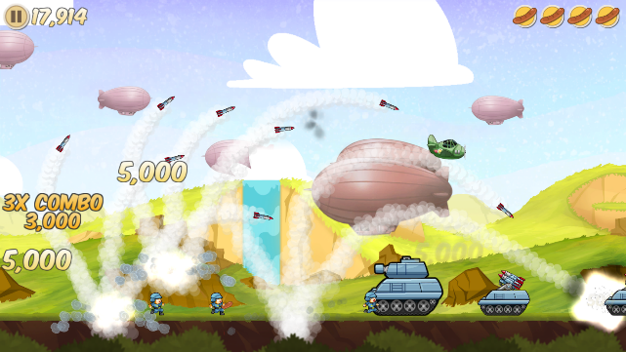
Thank you!
Let us know what you think!
www.katsugames.com
Katsu_entertainment
KatsuEntertainment
@StephaneImbert
@KatsuGames
Notes:
As indies word of mouth is everything
Follow us
Tell your friends about us
Tell us about your game flow experience
Tell us about this presentation

